Slide 1
Digital Image Processing Chapter 3: Intensity Transformations and Spatial Filtering
3.6 Sharpening Spatial Filters(3,4)
2020112275 이세완

Slide 2
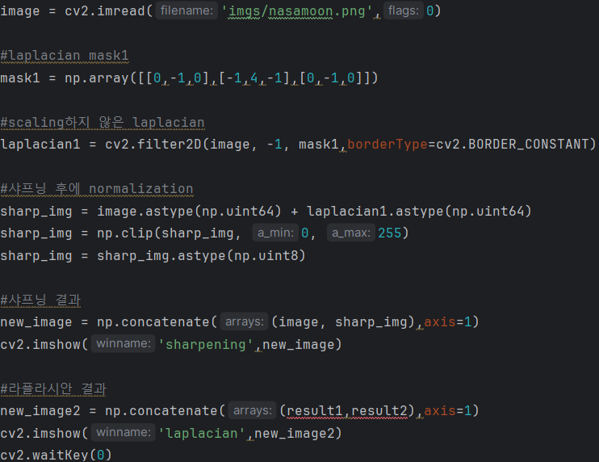
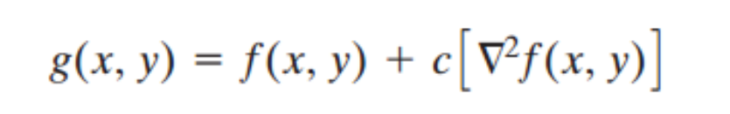
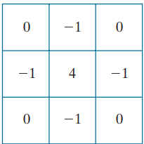
Homework
Using the Second Derivative for Image Sharpening – The Laplacian
＜Laplacian filter>

Slide 3
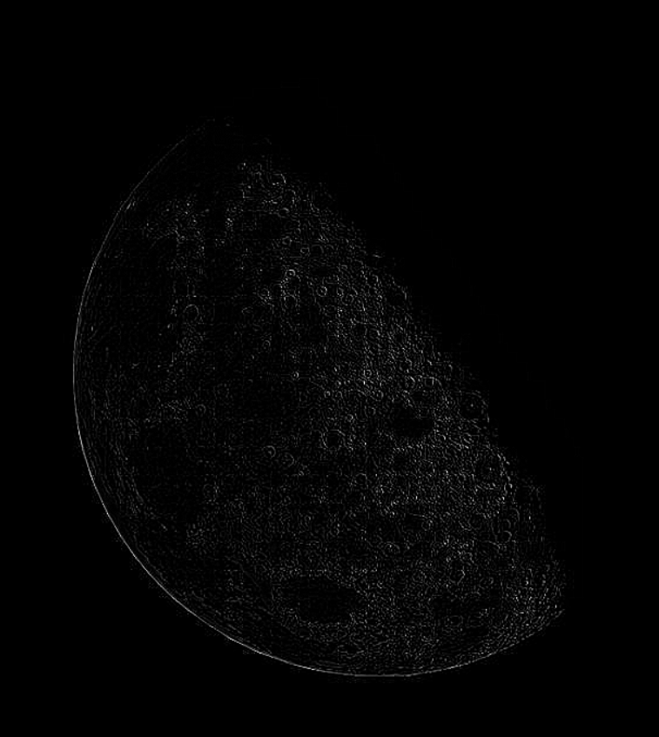
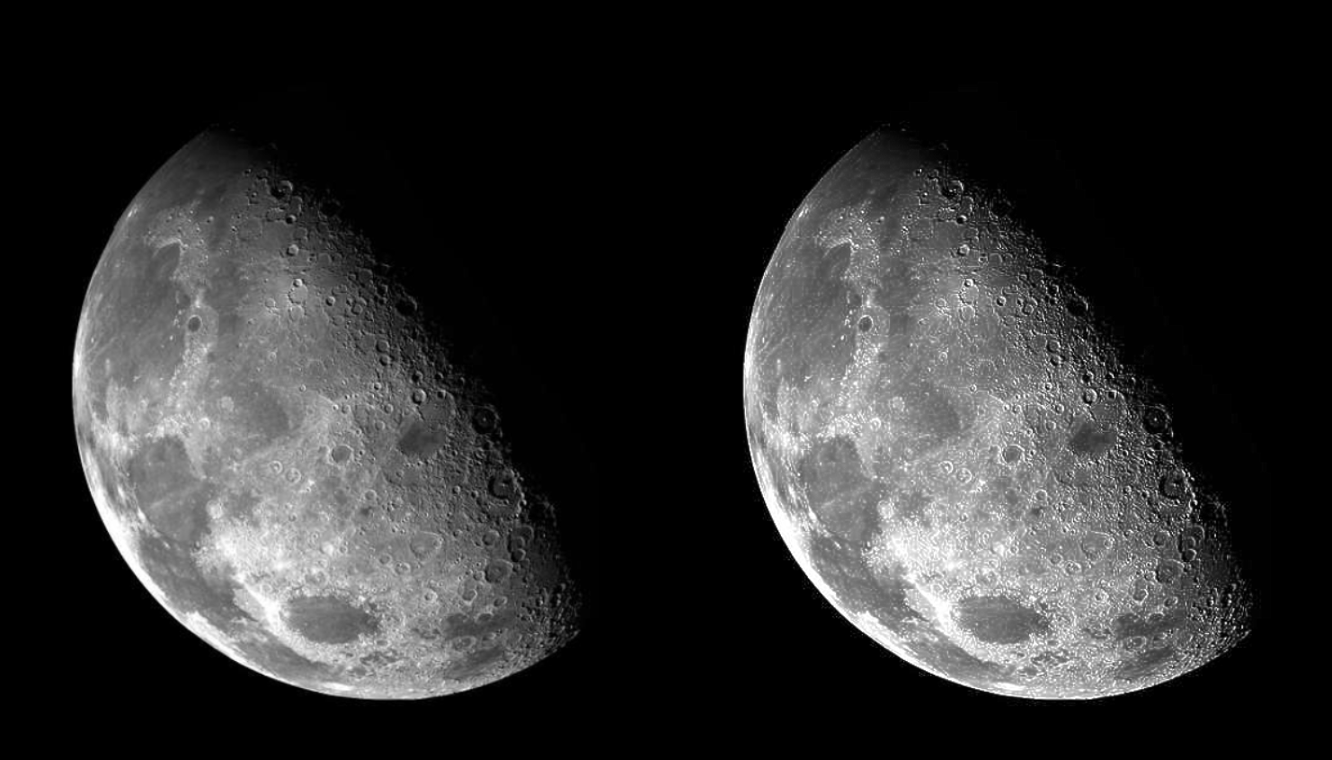
Homework
Using the Second Derivative for Image Sharpening – The Laplacian
＜Laplacian Image>
<original>
<sharpening (중앙 계수: 4)>

Slide 4
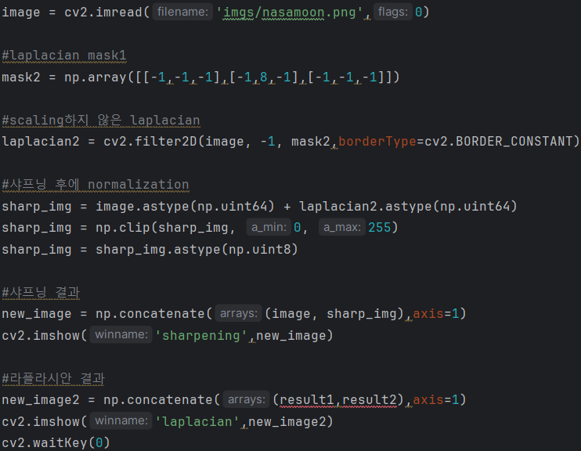
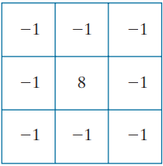
Homework
Using the Second Derivative for Image Sharpening – The Laplacian
＜Laplacian filter>

Slide 5
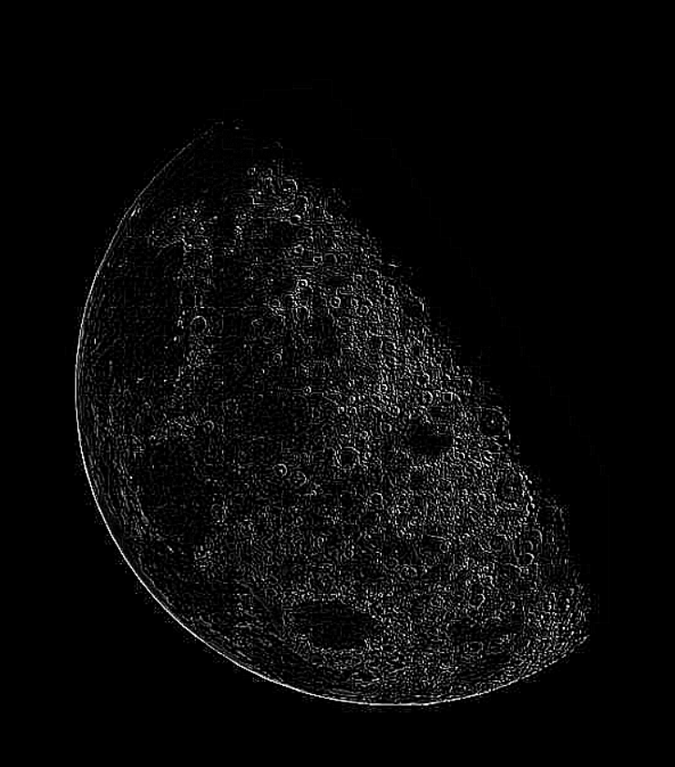
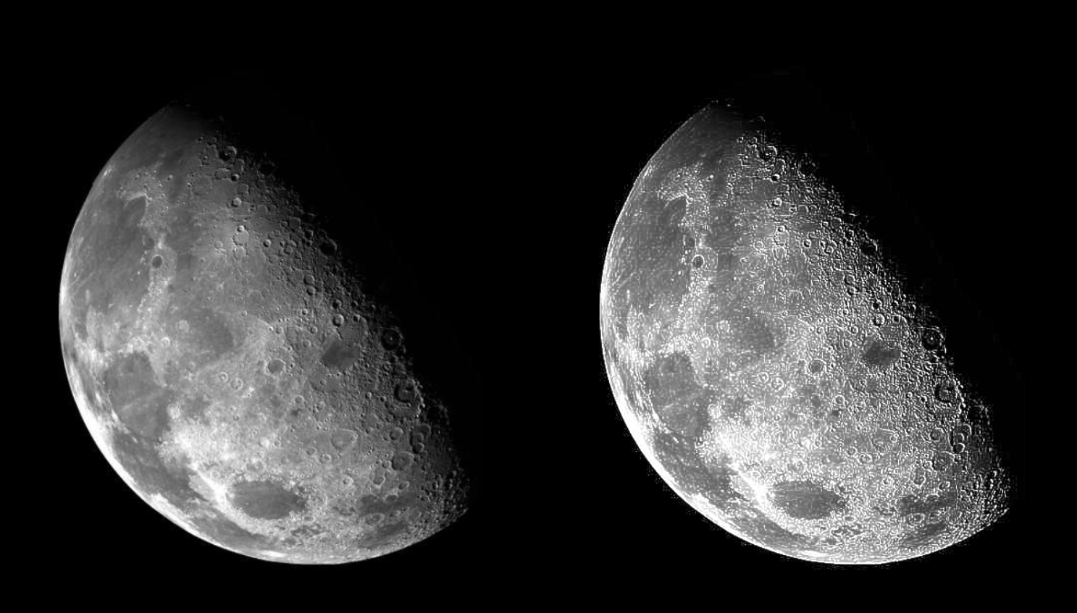
Homework
Using the Second Derivative for Image Sharpening – The Laplacian
＜Laplacian Image>
<original>
<sharpening (중앙 계수: 8)>

Slide 6
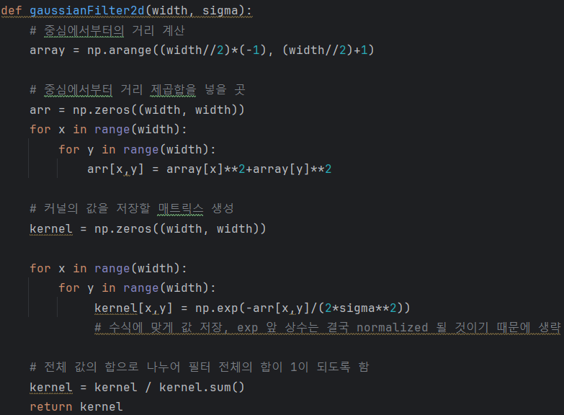
Homework
Retinex
Retinex: 배경 성분을 줄임 -> contrast, sharpness 향상
G(x,y) = log(f(x,y)) – log(gaussian image)

Slide 7
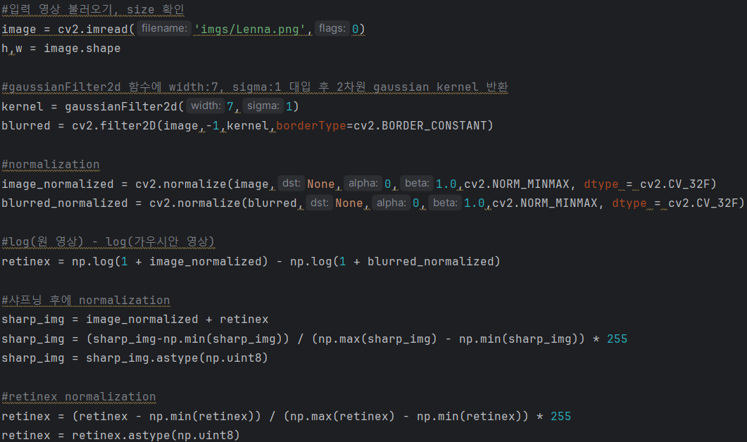
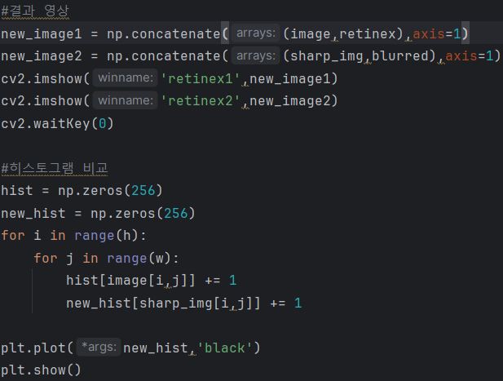
Homework
Retinex

Slide 8
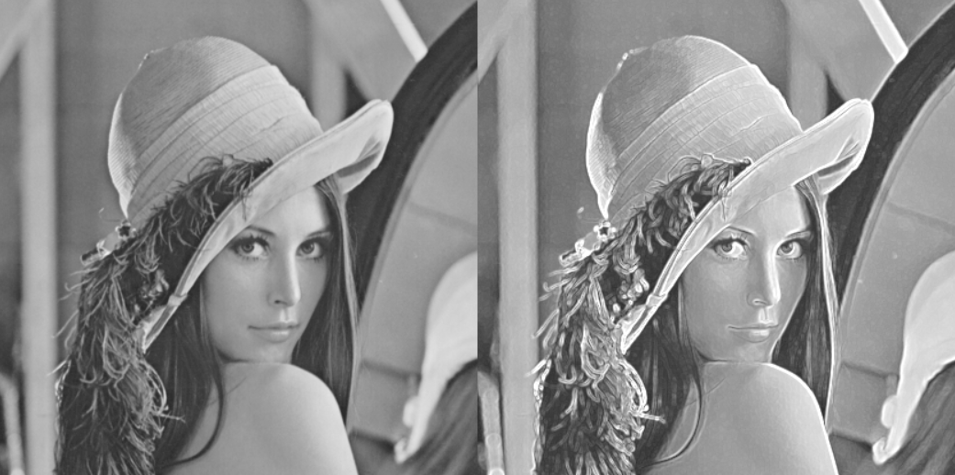
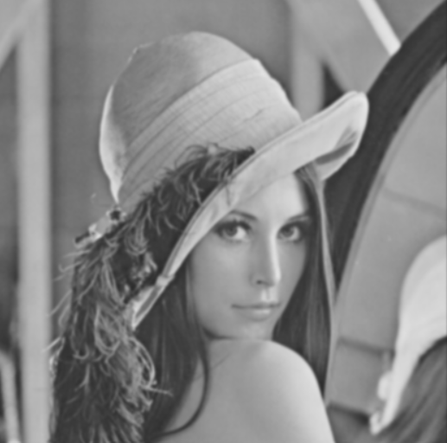
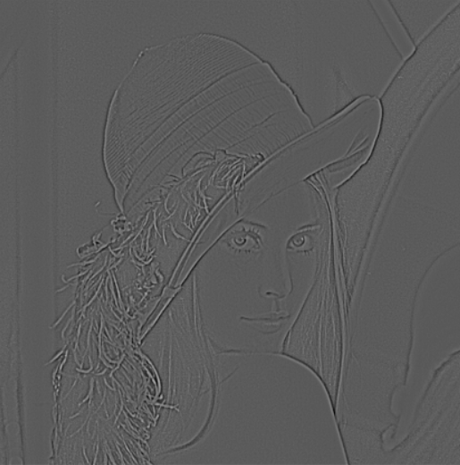
Homework
Retinex
G(x,y) = log(f(x,y)) – log(gaussian image)
<Original>
<Gaussian image>
<Retinex>

Slide 9

Homework
Retinex
<Original>
<Retinex>
<Result>
contrast, sharpness 향상

Slide 10
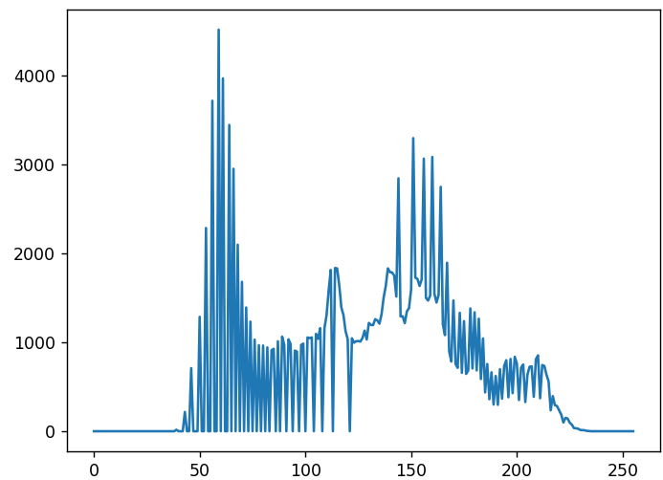
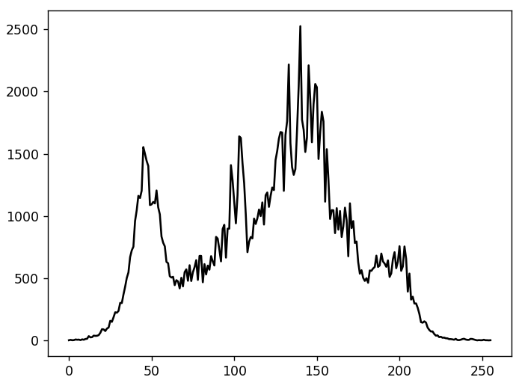
Homework
Retinex
＜Original>
＜Original + Retinex >

Slide 11
3.6 Sharpening Spatial Filters
3.6.1 Foundation
3.6.2 Using the Second Derivative for Image Sharpening – The Laplacian
3.6.3 Unsharp Masking and Highboost Filtering
3.6.4 Using First-Order Derivatives for(Nonlinear) Image Sharpening – The Gradient

Slide 12
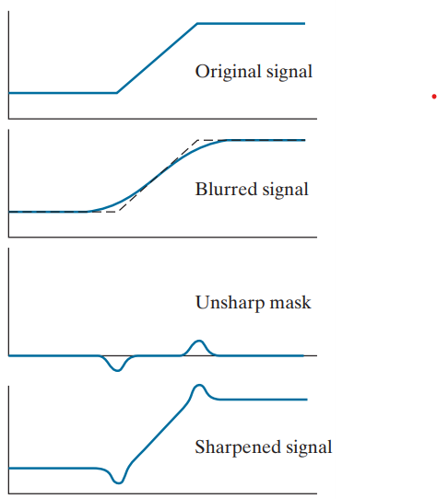
3.6 Sharpening Spatial Filters
3.6.3 Unsharp Masking and Highboost Filtering
<unsharp mask‘s mechanism>
①
(unsharp mask)
(blurred image)
②
(sharpened image)
(weight)
k=1: unsharp masking
k>1: highboost filtering

Slide 13
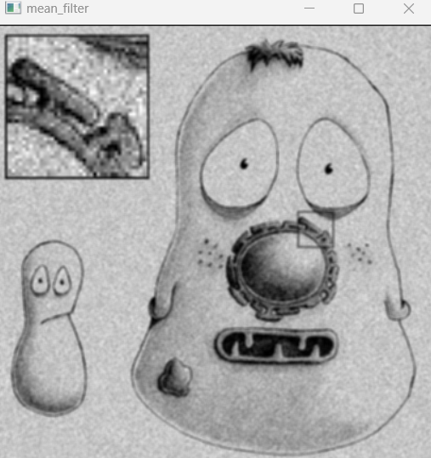
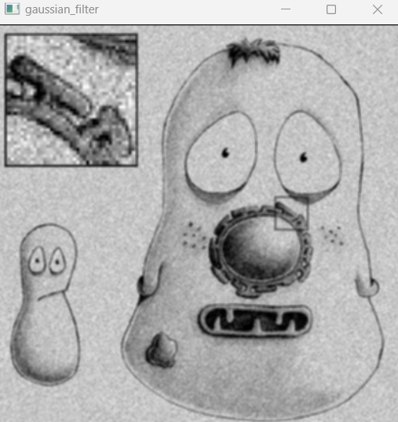
3.6 Sharpening Spatial Filters
3.6.3 Unsharp Masking and Highboost Filtering
<Blurred image: Mean Filter vs Gaussian Filter>
Mean Filter
kernel size: 3x3
Gaussian Filter
kernel size: 3x3
필터링 대상 위치에서 가까이 있는 픽셀과 멀리 있는 픽셀이 모두 같은 계수의 필터를 적용
필터링 대상 위치에서 가까운 픽셀은 계수가 크고 멀리 있는 픽셀은 계수가 작게 필터를 적용

Slide 14
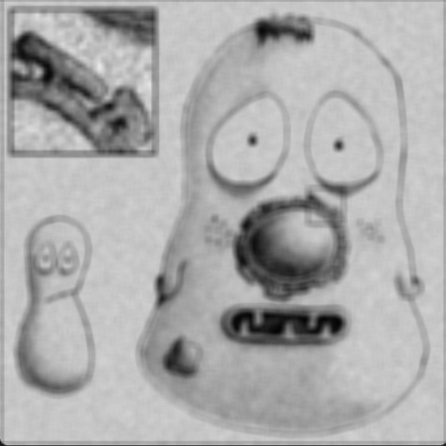
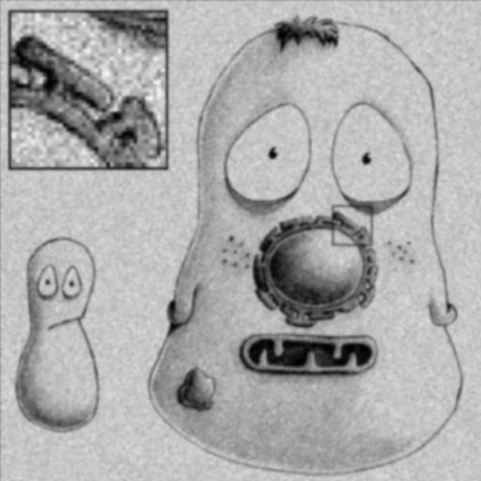
3.6 Sharpening Spatial Filters
3.6.3 Unsharp Masking and Highboost Filtering
<Blurred image: Mean Filter vs Gaussian Filter>
Mean Filter
kernel size: 7x7
Gaussian Filter
kernel size: 7x7
필터링 대상 위치에서 가까이 있는 픽셀과 멀리 있는 픽셀이 모두 같은 계수의 필터를 적용
필터링 대상 위치에서 가까운 픽셀은 계수가 크고 멀리 있는 픽셀은 계수가 작게 필터를 적용

Slide 15
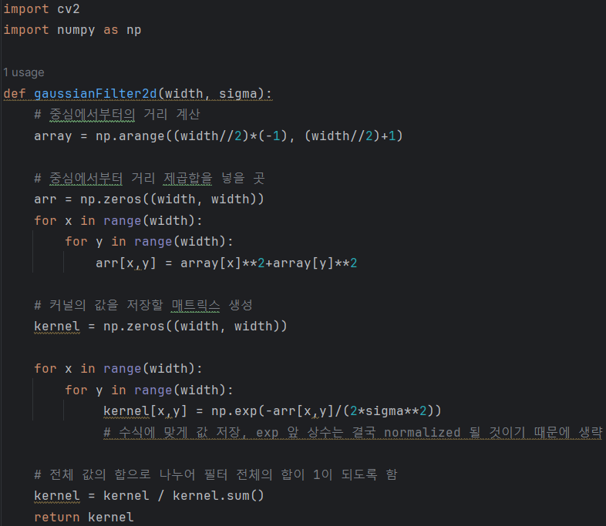
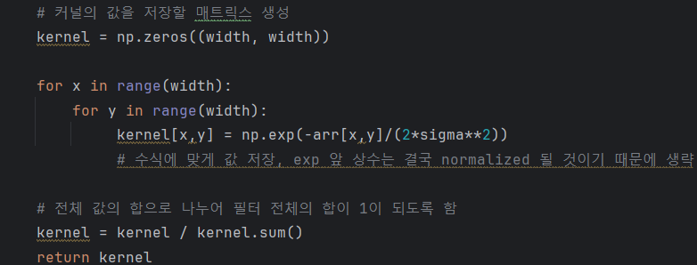
Unsharp masking(k=1)
g(x,y) = f(x,y) + k*g_mask(x,y)
=> g(x,y) = (k+1)*f(x,y) – k*blurred = 2*f(x,y) - blurred
Highboost filtering(k=4.5)
g(x,y) = f(x,y) + k*g_mask(x,y)
=> g(x,y) = (k+1)*f(x,y) – k*blurred = 5.5*f(x,y) – 4.5*blurred

Slide 16

3.6 Sharpening Spatial Filters
3.6.3 Unsharp Masking and Highboost Filtering
<31x31 gaussian>
<unsharp masking: k=1>
<highboost filtering: k=4.5>

Slide 17



3.6 Sharpening Spatial Filters
3.6.3 Unsharp Masking and Highboost Filtering
<original>
<5x5, σ=3 gaussian>
<unsharp masking>
<original>
<31x31, σ=3 gaussian>
<unsharp masking>
<original>
<31x31, σ=5 gaussian>
<unsharp masking>
-> Blurring 효과 클 수록 엣지가 더 강조됨

Slide 18
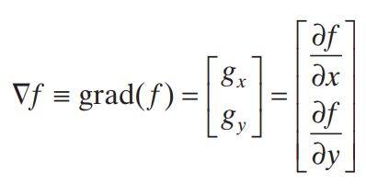
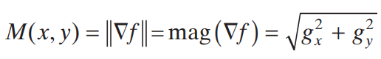
3.6 Sharpening Spatial Filters
3.6.4 Using First-Order Derivatives for(Nonlinear) Image Sharpening – The Gradient
(gradient image)

Slide 19
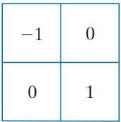
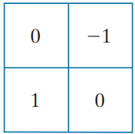
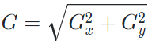
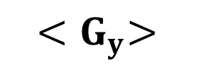
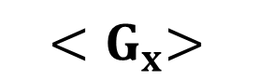
3.6 Sharpening Spatial Filters
3.6.4 Using First-Order Derivatives for(Nonlinear) Image Sharpening – The Gradient
<Roberts Cross Operator>
$${<G}_{x}>$$
$${<G}_{y}>$$

Slide 20
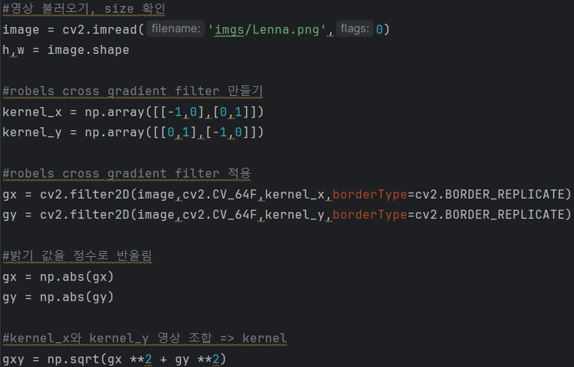
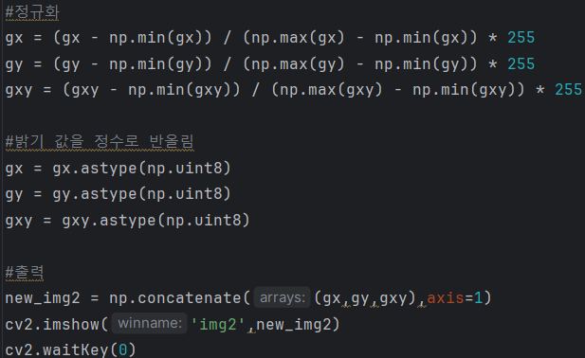
3.6 Sharpening Spatial Filters
3.6.4 Using First-Order Derivatives for(Nonlinear) Image Sharpening – The Gradient
<Roberts Cross Operator>

Slide 21
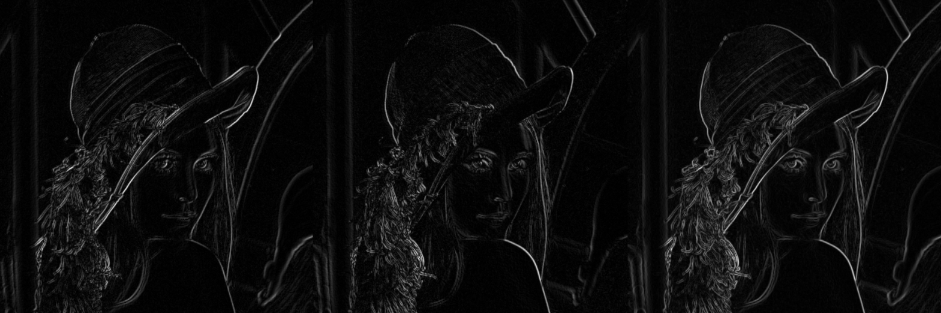


3.6 Sharpening Spatial Filters
3.6.4 Using First-Order Derivatives for(Nonlinear) Image Sharpening – The Gradient
$${<G}_{x}>$$
$${<G}_{y}>$$

Slide 22
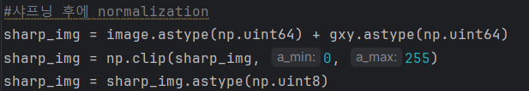
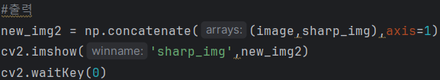

3.6 Sharpening Spatial Filters
3.6.4 Using First-Order Derivatives for(Nonlinear) Image Sharpening – The Gradient
<Original>
<Original + Gradient image>

Slide 23
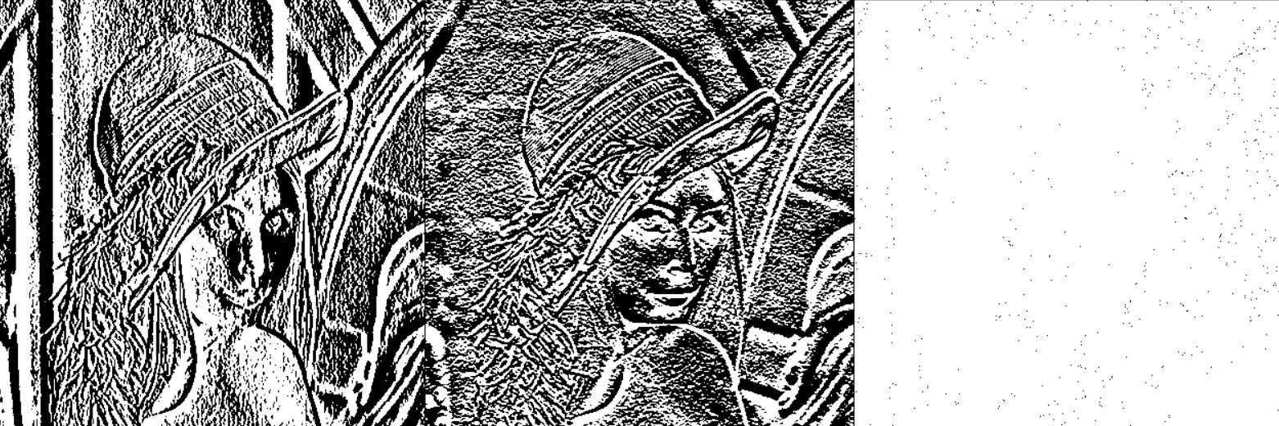
3.6 Sharpening Spatial Filters
3.6.4 Using First-Order Derivatives for(Nonlinear) Image Sharpening – The Gradient
<Sobel Operator - Review>
<수평방향>
<수직방향>
<수평 + 수직방향>

Slide 24
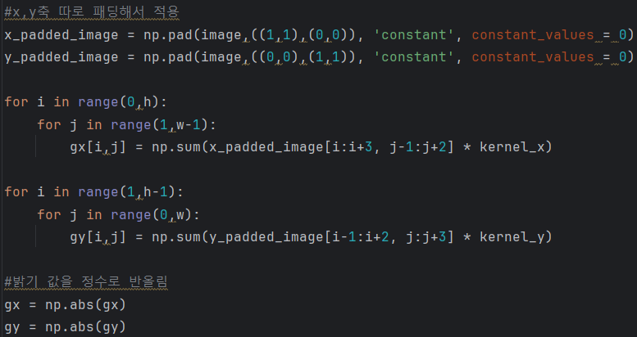
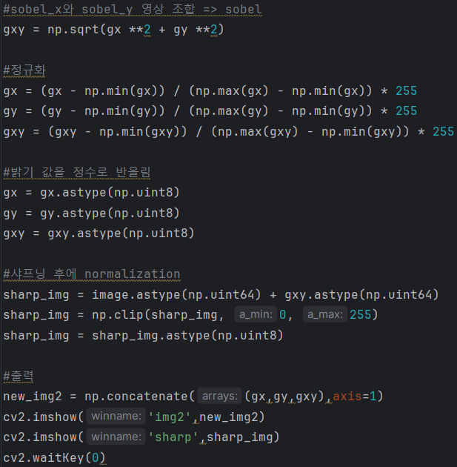
3.6 Sharpening Spatial Filters
3.6.4 Using First-Order Derivatives for(Nonlinear) Image Sharpening – The Gradient
<Sobel Operator>

Slide 25
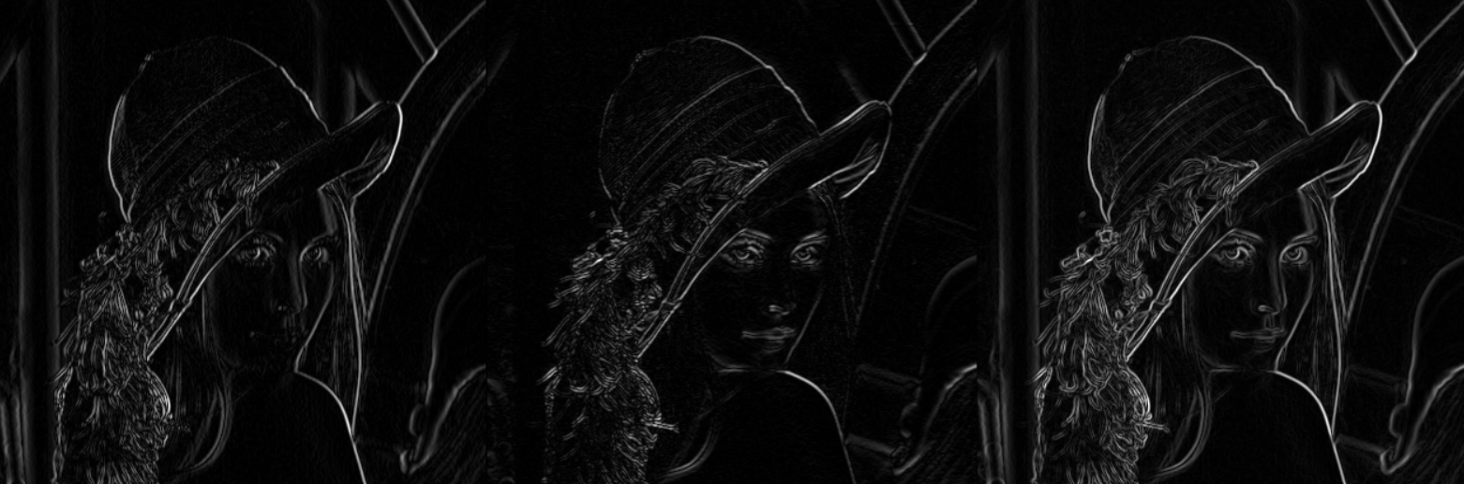
3.6 Sharpening Spatial Filters
3.6.4 Using First-Order Derivatives for(Nonlinear) Image Sharpening – The Gradient
<Sobel Operator - Review>
<수평방향>
<수직방향>
<수평 + 수직방향>

Slide 26
3.6 Sharpening Spatial Filters
3.6.4 Using First-Order Derivatives for(Nonlinear) Image Sharpening – The Gradient
<Sobel Operator>
<Original>
<수평+수직방향>
<sharpening>

Slide 27
Q&A
<Code>
2, 4p – Sharpening with Laplacian filter
6, 7p – Retinex
15p – Unsharp masking & Highboost filtering
20, 22p – Sharpening with Roberts cross filter
25, 26p – Sharpening with Sobel filter

